Slide 1

SOURCE CONTROL MANAGEMENT (SCM)
Lecturer: Dr. Muhammad Iqbal
Email: miqbal@cct.Ie
CCT College Dublin
CCT College Dublin
CCT COLLEGE DUBLIN
CCT COLLEGE DUBLIN
CCT COLLEGE DUBLIN
CCT COLLEGE DUBLIN
CCT COLLEGE DUBLIN
CCT COLLEGE DUBLIN

Slide 2
OUTLINE
Source control management (scm)
Why scm? And WHAT DO YOU MANAGE?
Scm types
GIT: CONCEPTS, BRANCHES, TAGS, MERGE VS REBASE and MERGE & CONFLICTS
Project management
SCM lab using Git and Github
CCT COLLEGE DUBLIN
CCT COLLEGE DUBLIN
CCT COLLEGE DUBLIN
CCT COLLEGE DUBLIN
CCT COLLEGE DUBLIN

Slide 3
SOURCE CONTROL MANAGEMENT (SCM)
Source control management (SCM) refers to tools that help you to keep track of your code with a complete history of changes.
Source Control Management (SCM) is better known as Revision Control Management.
CCT COLLEGE DUBLIN
CCT COLLEGE DUBLIN
CCT COLLEGE DUBLIN

Slide 4
SOURCE CONTROL MANAGEMENT (SCM)
SCM is necessary to keep projects under control, especially on multi-projects spanning different environments.
A good SCM system should manage the following
Versioning and chronological changes
Comparing and merging
Restoring to checkpoint
CCT COLLEGE DUBLIN

Slide 5
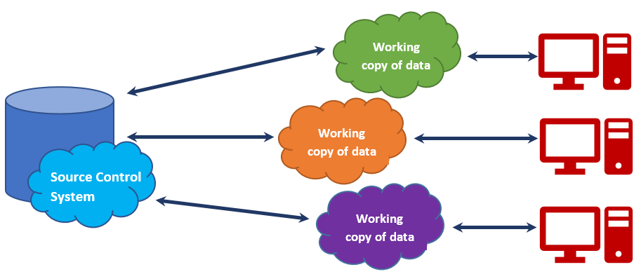
SOURCE CONTROL MANAGEMENT (SCM)
A source control system is a component of a source repository and version management system. If you are building enterprise-level applications in a distributed environment, you will want to keep your source code in a safe vault with easy-to-manage, easy-to-integrate, and easy-to-create versions of each check-in.
The source control repository helps you to manage your code. There are plenty of source control repositories available in the market. Some of the most common repositories are Git, TFS, and SVN.
CCT COLLEGE DUBLIN
CCT COLLEGE DUBLIN
CCT COLLEGE DUBLIN
Notes:
Team Foundation Server (Microsoft TFS) helps to manage teams and their code. It's because TFS offers a combo of version control, issue tracking, and application lifecycle management.
Apache Subversion is a software versioning and revision control system distributed as open source under the Apache License. Software developers use Subversion to maintain current and historical versions of files such as source code, web pages, and documentation.

Slide 6
SOURCE CONTROL MANAGEMENT (SCM)
In general, repositories are being hosted on on-premise environments or in a cloud-hosted environment such as Microsoft Team Services, Team Foundation Server, GitHub, Bitbucket, and so on, and developers connect to the remote repository to clone the entire changeset on their system to perform changes on their code.
When the changes are over and well tested, they push those changes to the remote.
We discuss the following core points to use a source control repository such as Git and Github Project using Github environment.
CCT COLLEGE DUBLIN
CCT COLLEGE DUBLIN

Slide 7
WHY SCM?
How to share the work?
How to keep track of changes and its authors?
CCT COLLEGE DUBLIN
CCT COLLEGE DUBLIN
CCT COLLEGE DUBLIN

Slide 8
HISTORY
The concept started with engineering
  Drawing and project offices evolved a robust system for dealing with engineering processes, and thus were born the fledgling change control and release systems.
Modern implementation in software development since ~1980
Git started in 2005
CCT COLLEGE DUBLIN
CCT COLLEGE DUBLIN
CCT COLLEGE DUBLIN

Slide 9
WHAT DO YOU MANAGE?
Code, or any text based projects (like all the configuration needed for the project)
Manage project versions
  Global project version (tags)
  Each modification is a «version»
Change requests
CCT COLLEGE DUBLIN
CCT COLLEGE DUBLIN
CCT COLLEGE DUBLIN

Slide 10
SCM TYPES
CENTRALIZED
has single central repository
single point of failure
requires a network to inspect a history
Examples: Tortoise SVN
CCT COLLEGE DUBLIN
CCT COLLEGE DUBLIN
CCT COLLEGE DUBLIN
Notes:
TortoiseSVN is a Subversion client, implemented as a Microsoft Windows shell extension, that helps programmers to manage different versions of the source code for their programs. It is free software released under the GNU General Public License.

Slide 11
SCM TYPES
DISTRIBUTED
local repository with full history
independent work
Examples: Git, Mercurial SCM
CCT COLLEGE DUBLIN
CCT COLLEGE DUBLIN
CCT COLLEGE DUBLIN
Notes:
Mercurial is a distributed revision control tool for software developers. It is supported on Microsoft Windows and Unix-like systems, such as FreeBSD, macOS, and Linux.

Slide 12
GIT: VIEWING
We can understand from Bootstrap repository to view the state of a project and to gain an insight what’s going on, so you can find areas that could be improved or so you can be familiar with the interface when you’re ready to contribute.
Bootstrap is a repository that allows developers to quickly develop attractive web applications. We use the popular Bootstrap open source project as an example.
Viewing the README.md File
Viewing the Commit History
Viewing Pull Requests
https://github.com/twbs/bootstrap
CCT COLLEGE DUBLIN
Notes:
A fork is a copy of a repository that you manage. Forks let you make changes to a project without affecting the original repository. You can fetch updates from or submit changes to the original repository with pull requests.

Slide 13
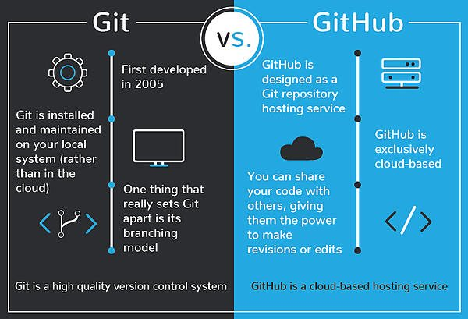
GIT AND GITHUB
Git: Git is a version control system for tracking changes (SCM) in computer files and coordinating work on those files among multiple people. It is designed for coordinating work among programmers, but it can be used to track changes in any set of files. Its goals include speed, data integrity, and support for distributed, non-linear workflows.
GitHub: GitHub is a web-based Git repository hosting service, which offers all of the distributed revision control and source code management (SCM) functionality of Git as well as adding its own features.
CCT COLLEGE DUBLIN

Slide 14
GIT AND GITHUB
If you need to use Microsoft Dynamics NAV or Microsoft Dynamics 365 Business Central with SCM integration, Git is the best solution (free, open source and natively integrated with VS Code).
Git is an open source distributed version control engine. VS Code supports Git natively. Some Git commands are as follows:
git remote add origin master <repo url>
git push -u origin master
git push -u add master
The Git local repository commits to GitHub, pushes the content of the local repository into the branch called master.
CCT COLLEGE DUBLIN
Notes:
Microsoft Dynamics NAV is an enterprise resource planning app from Microsoft.

Slide 15
GIT: PROJECT MANAGEMENT
For project management with GitHub, you can get better understanding for software development even if you’re not writing code.
Project management on GitHub typically starts in the form of simple task items that need to be worked on with GitHub Issues, organizing GitHub issues by applying labels to them and giving them deadlines with milestones.
Finally, if your work involves project managers or more teams, you may decide to collect your issues and pull requests onto boards with GitHub Projects.
GitHub Issues provide a lightweight, easy-to-use tool for managing outstanding work—whether it’s bugs that need to be fixed or new features that need to be built.
Generally, when starting a new project, someone may begin by managing both bugs and features using GitHub Issues.
Later they may move to another tool like ZenHub, Waffle.io, or JIRA if they need features that GitHub Issues does not provide.
CCT COLLEGE DUBLIN

Slide 16
GIT: CONCEPTS
Learn git - https://git-scm.com/doc
Git Project
Each set of changes to files are commits
Each commit has a parent commit (except for the first one)
The current commit is the HEAD
The git project is kept in a remote location - repository
Retrieving changes from the repo is pulling
Sending changes to the repo is pushing
When choosing what to commit, files are staged
CCT COLLEGE DUBLIN
CCT COLLEGE DUBLIN
CCT COLLEGE DUBLIN

Slide 17
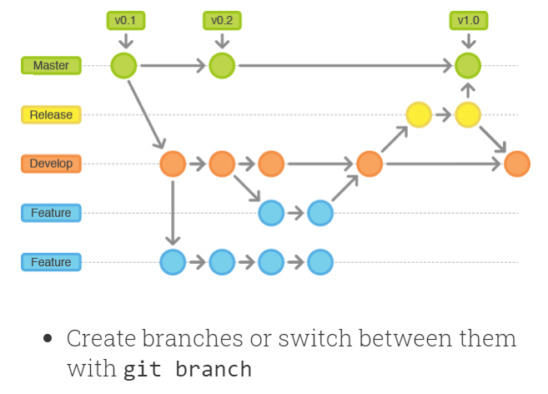
GIT: BRANCHES
Branches - independent set of commits
So far all the commits are on the master branch
Branch can be an abstraction for the line of development
  master is the stable, tested version of the project
  develop is the place where features come together
  feature is the branch for single feature
Branch can be temporary:
  To have a change request
  To develop an independent feature
CCT COLLEGE DUBLIN
CCT COLLEGE DUBLIN
CCT COLLEGE DUBLIN

Slide 18
GIT: TAGS
So far:
changes are managed, not the project
all the commits come one after the other
the only version available is the commit id
Tagging versions:
Tag a commit to be a particular software version
Easier to identify the versions
You have to push the tags
CCT COLLEGE DUBLIN
CCT COLLEGE DUBLIN
CCT COLLEGE DUBLIN

Slide 19
GIT: MERGE & CONFLICTS
Branches can be merged to have all the changes in only one branch.
When multiple changes are in conflict with each other, the merge fails: Automatic merge failed; fix conflicts and then commit the result.
Solutions:
Cherrypick the changes (can be quite long)
Abandon your changes (and put them back later)
Work on the latest commit (git pull) and have a good task repartition
CCT COLLEGE DUBLIN
CCT COLLEGE DUBLIN
CCT COLLEGE DUBLIN
Notes:
Cherry picking is the act of picking a commit from a branch and applying it to another. git cherry-pick can be useful for undoing changes. For example, say a commit is accidently made to the wrong branch. You can switch to the correct branch and cherry-pick the commit to where it should belong.

Slide 20
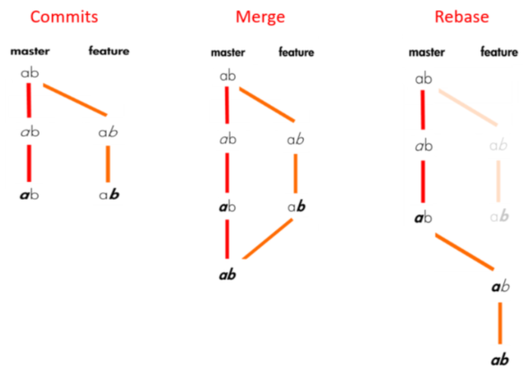
GIT: MERGE VS REBASE
Read this article on Medium.
CCT COLLEGE DUBLIN
CCT COLLEGE DUBLIN
CCT COLLEGE DUBLIN
Notes:
The git rebase command allows you to easily change a series of commits, modifying the history of your repository. You can reorder, edit, or squash commits together. Typically, you would use git rebase to: Edit previous commit messages. ... Delete or revert commits that are no longer necessary.

Slide 21
OPEN SOURCE PROJECT MANAGEMENT
Code managed by git, how can people contribute?
Fork the project on your account
Work on a change on your fork
Ask for your changes to be added to the official code - pull request
CCT COLLEGE DUBLIN
CCT COLLEGE DUBLIN
CCT COLLEGE DUBLIN

Slide 22
PROJECT MANAGEMENT WITH GITLAB
Provides from basic issue tracking to scrum and kanban style
Track and manage issues
Issue boards to visualize work
Agile project management
DevOps pipeline traceability
Read more about GitLab project management.
CCT COLLEGE DUBLIN
CCT COLLEGE DUBLIN
CCT COLLEGE DUBLIN
Notes:
Kanban is a workflow management method for defining, managing and improving services that deliver knowledge work. It aims to help you visualize your work, maximize efficiency, and improve continuously. Originating from manufacturing, it later became a territory claimed by Agile software development teams.

Slide 23
SCM LAB
OBJECTIVES
Perform the Github Desktop Tutorial
Create a repository and clone it on your computer
Create a branch and navigate between branches
Modify a file in the repository and push the modifications
Manage conflicts
CCT COLLEGE DUBLIN
CCT COLLEGE DUBLIN
CCT COLLEGE DUBLIN

Slide 24
BEFORE STARTING
Install Git on your Operating system
Create a Github account: https://github.com/
Install Github Desktop from this url: https://desktop.github.com/
Install an IDE or text editor (ex: https://code.visualstudio.com/ or https://atom.io/)
Create an account on Github if you do not have already.
CCT COLLEGE DUBLIN
CCT COLLEGE DUBLIN
CCT COLLEGE DUBLIN

Slide 25
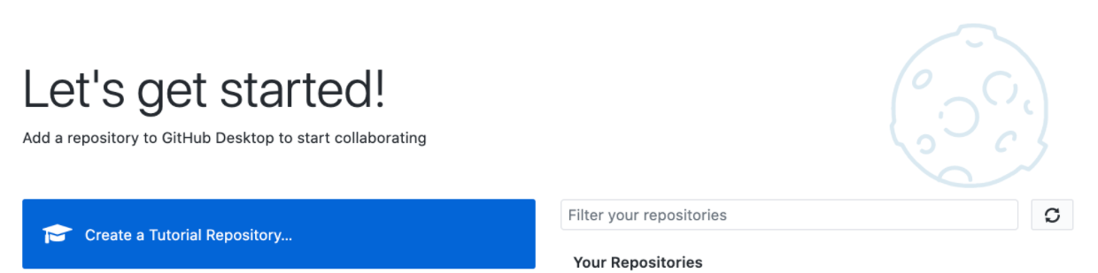
1. PERFORM THE GITHUB DESKTOP TUTORIAL
Launch Github Desktop
Start the Github Desktop Tutorial by clicking "Create a Tutorial Repository ..." and follow the instructions
CCT COLLEGE DUBLIN
CCT COLLEGE DUBLIN
CCT COLLEGE DUBLIN

Slide 26
2. CREATE A REPOSITORY AND CLONE IT ON YOUR COMPUTER
A single member of the group creates a repository
Log into Github.com
Navigate to the "Your repositories" page
Click on "New"
  Choose a name
  Chose the "Public" option
  Check the box "Add a README file"
  Check the box "Add .ignore" with the "Node" template
Navigate to the created repository, then to the Settings → Manage Access page
Click on "Invite a collaborator" and add the other members of your group
CCT COLLEGE DUBLIN
CCT COLLEGE DUBLIN
CCT COLLEGE DUBLIN

Slide 27
2. CREATE A REPOSITORY AND CLONE IT ON YOUR COMPUTER
All group members clone the repository
Open Github Desktop
Click on "Clone a repository from the Internet"
GitHub.com → Filter your repositories
Click on “Clone”
You now have a copy of the local repository
CCT COLLEGE DUBLIN
CCT COLLEGE DUBLIN
CCT COLLEGE DUBLIN

Slide 28
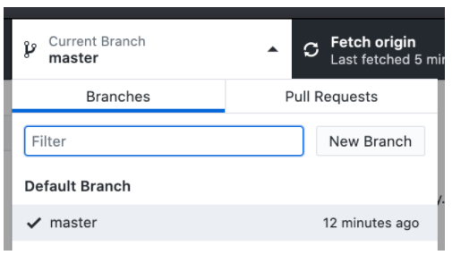
3. CREATE A BRANCH AND NAVIGATE BETWEEN BRANCHES
A single member of the group creates the develop branch:
In Github Desktop: Current branch → New branch
Choose the name of the branch (develop) and "Create branch"
You can now navigate (= checkout) between the master and develop branches
CCT COLLEGE DUBLIN
CCT COLLEGE DUBLIN
CCT COLLEGE DUBLIN

Slide 29
4. MODIFY A FILE IN THE REPOSITORY AND PUSH THE MODIFICATIONS
A single member of the group modifies the "README.md" file and pushes to the develop branch:
Modify the "README.md" file entirely:
Open the repository in your IDE
Replace the entire contents of the "README.md" file
In Github Desktop:
Choose a commit message ("Summary")
Click on "Commit to develop"
Use "Publish branch" to push your changes to the remote repository
CCT COLLEGE DUBLIN
CCT COLLEGE DUBLIN
CCT COLLEGE DUBLIN

Slide 30
4. MODIFY A FILE IN THE REPOSITORY AND PUSH THE MODIFICATIONS
The other members of the group get the changes
Use "Fetch origin" to synchronize your local repository with remote changes
Navigate to the develop branch and watch your files change in your IDE
CCT COLLEGE DUBLIN
CCT COLLEGE DUBLIN
CCT COLLEGE DUBLIN

Slide 31
5. MANAGE CONFLICTS
A conflict occurs when a part of a file has been modified on 2 branches which must be merged (merge). We will create a conflict to see how to resolve it.
Both 2 members of the group create a branch from develop and modify the same part (same lines) of the README.md file:
Create a branch dev-firstname "based on ... develop"
Edit the README.md file
Commit changes
Push your changes
CCT COLLEGE DUBLIN
CCT COLLEGE DUBLIN
CCT COLLEGE DUBLIN

Slide 32
5. MANAGE CONFLICTS
Alternately, each member merges the new branches into develop
Checkout the develop branch
Click on "Merge into current branch ..."
Select branch
Push your changes
The 2nd member of the group will encounter a conflict
Open your IDE as suggested by Github Desktop
The conflict materialize as follows:
CCT COLLEGE DUBLIN
CCT COLLEGE DUBLIN
CCT COLLEGE DUBLIN

Slide 33
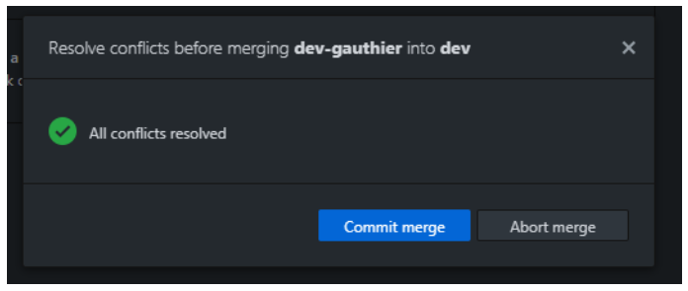
5. MANAGE CONFLICTS
To resolve the conflict, keep either the HEAD part, or the dev-firstname part and delete the other lines (including the ==== and >>>> lines)
Once the lines are deleted you can commit the merge from Github Desktop:
CCT COLLEGE DUBLIN
CCT COLLEGE DUBLIN
CCT COLLEGE DUBLIN

Slide 34
6. REDO THE LAB USING COMMAND LINE INTERFACE (CLI)
The goal is to redo the same actions as before with the command line. For this you must have a terminal and GIT installed by default on Linux or MacOS.
For the installation:
Windows: https://gitforwindows.org/
Linux: https://git-scm.com/download/linux
MacOS: https://git-scm.com/download/mac
You can now open Terminal (on Linux or MacOS) or Git Bash (on Windows).
CCT COLLEGE DUBLIN
CCT COLLEGE DUBLIN
CCT COLLEGE DUBLIN

Slide 35
6. REDO THE LAB USING COMMAND LINE INTERFACE (CLI)
You can find a detailed list of the different GIT CLI commands:
https://gist.github.com/aquelito/8596717
https://github.github.com/training-kit/downloads/github-git-cheat-sheet.pdf
https://www.geeksforgeeks.org/difference-between-git-and-github/
CCT COLLEGE DUBLIN
CCT COLLEGE DUBLIN
CCT COLLEGE DUBLIN

Slide 36
BONUS TASKS
Add multiple remotes (reference here)
Squashing commits (reference here and here)
Reverting history (reference here and here)
Rebasing (reference here)
Cherry-picking (reference here and here)
Learn Monorepos in Git (reference here)
CCT COLLEGE DUBLIN
CCT COLLEGE DUBLIN
CCT COLLEGE DUBLIN

